Slide 1
Travel ai agent
IBM HACKATHON PROJECT
Presented By: Saptashwa Das
Student name : Saptashwa Das
College Name : Kalinga Institute of Industrial Technology
Department:Computer Science & Engineering

Slide 2
OUTLINE
Problem Statement
Technology used
Wow factor
End users
Result
Conclusion
Git-hub Link
Future scope
IBM Certifications

Slide 3
Problem Statement
A Travel Planner Agent is an AI-powered assistant that helps users plan trips efficiently and intelligently.
It uses real-time data to suggest destinations, build itineraries, and recommend transport and accommodation options.
By understanding user preferences, budgets, and constraints, it tailors personalized travel plans.
Proposed Solution:
Integrated with maps, weather updates, and local guides, it ensures a smooth travel experience.
The agent can also manage bookings, alert users to changes, and optimize schedules on the go.
This smart assistant transforms complex travel planning into a seamless, enjoyable process.

Slide 4
Technology used
IBM cloud lite services
Natural Language Processing (NLP)
Retrieval Augmented Generation (RAG)
IBM Granite model

Slide 5
IBM cloud services used
IBM Cloud Watsonx AI Studio
IBM Cloud Watsonx AI runtime
IBM Cloud Agent Lab
IBM Granite foundation model

Slide 6
Wow factors
Personalized itineraries based on user preferences and budget
Real-time data for transport, hotels, and weather
Smart destination suggestions with hidden gems
Automatic itinerary updates on delays or changes
Live price estimates via Google search or vector data
All-in-one planning — from booking to alerts
Saves time by automating complex travel tasks
Human-like conversation for a natural experience

Slide 7
End users
Individual travelers (solo or group)
Business professionals planning work trips
Travel agencies and tour operators
Students and academic travelers
Families planning vacations
Digital nomads and remote workers
Event organizers (conferences, weddings, etc.)
Corporate travel departments

Slide 8
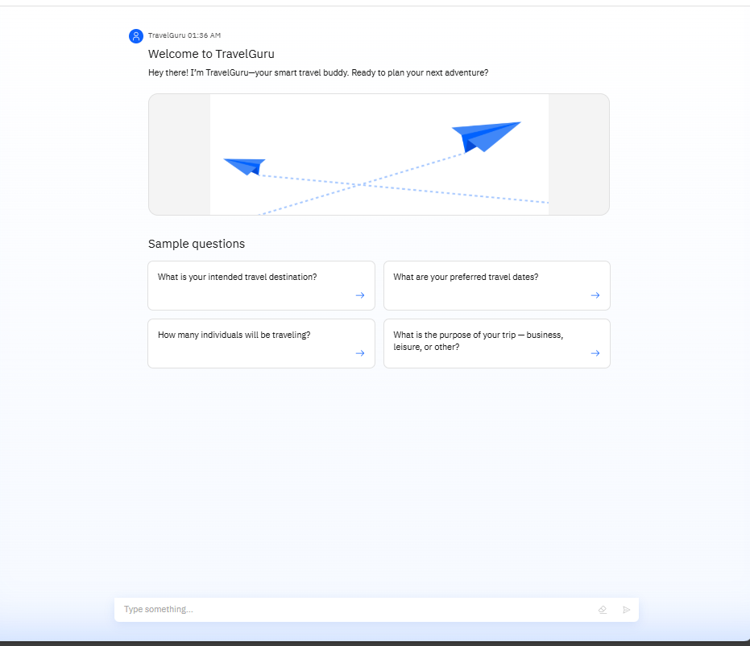
Results

Slide 9
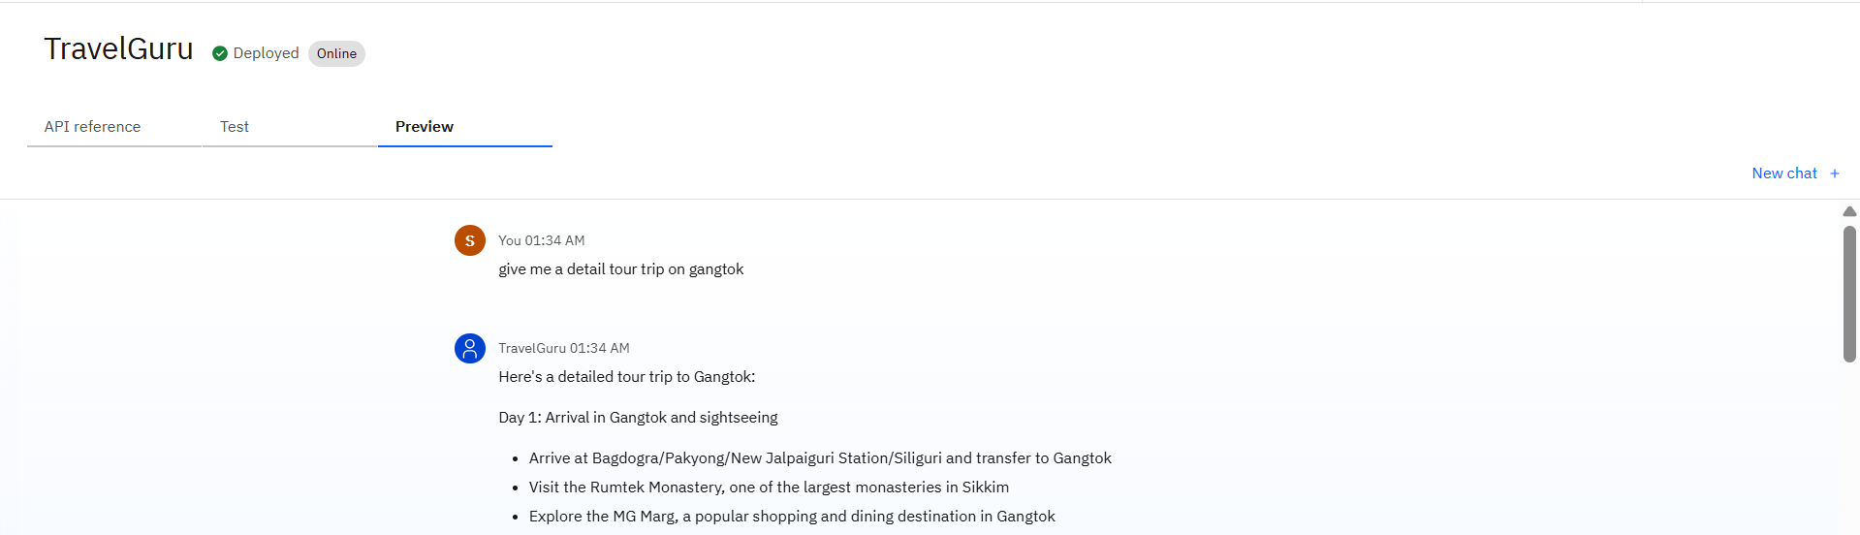
Results

Slide 10
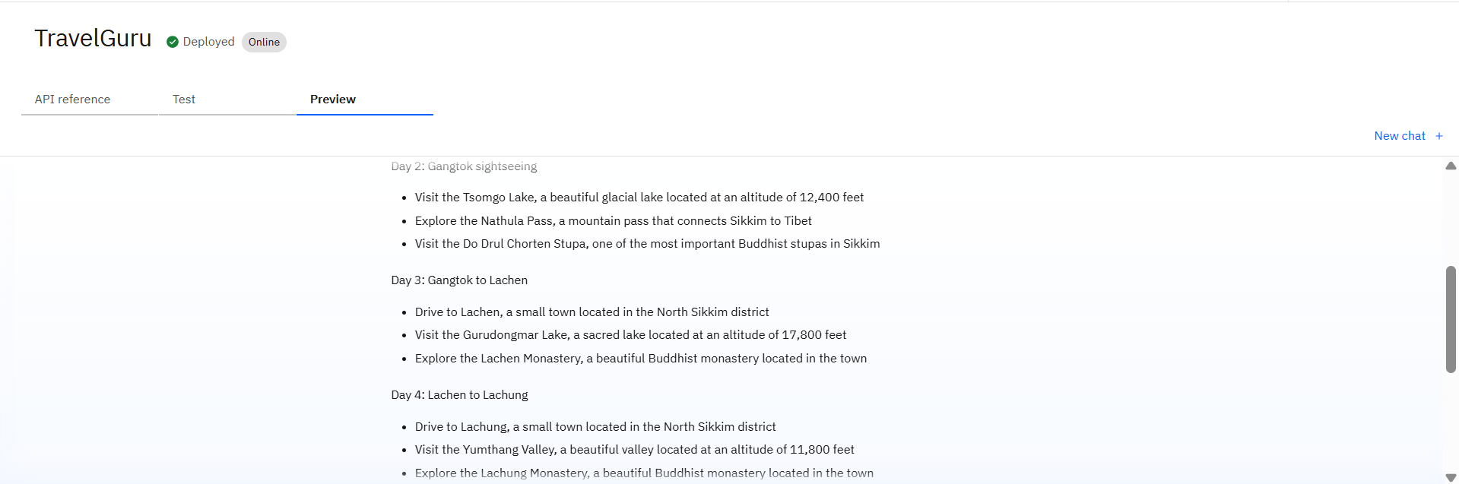
Results

Slide 11
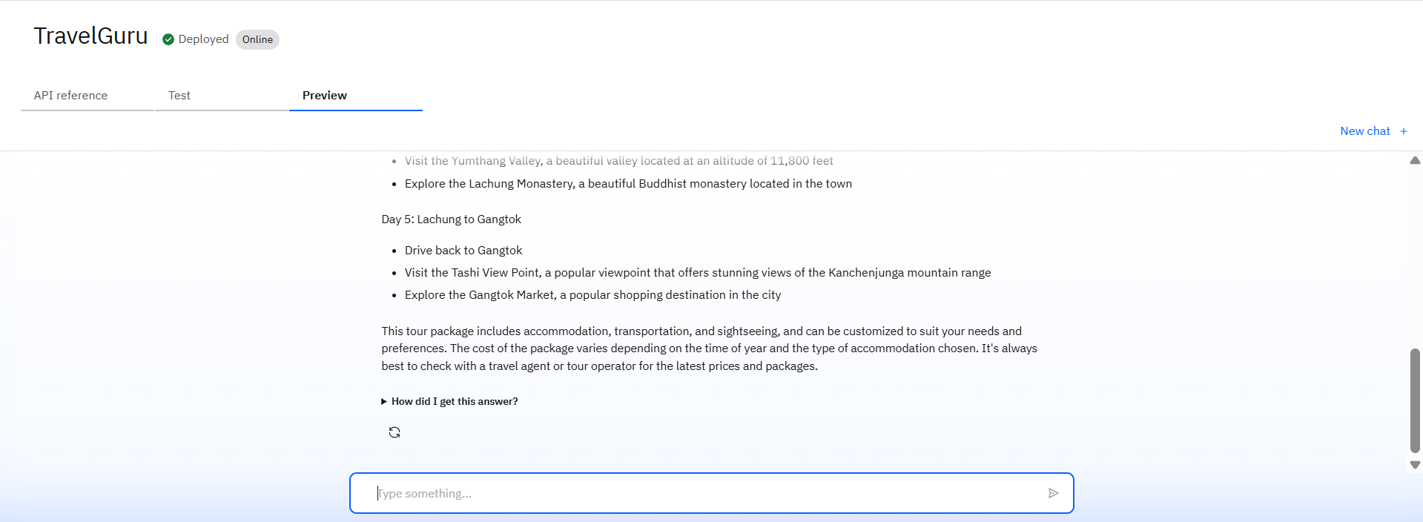
Results

Slide 12
Conclusion
Simplifies and automates complex travel planning tasks
Provides personalized, budget-friendly itineraries
Uses real-time data for accurate suggestions and updates
Enhances user experience through intelligent interaction
Adapts dynamically to changes like delays or cancellations
Saves time and reduces the stress of manual planning
Offers an all-in-one solution for modern travelers

Slide 13
Future scope
Integration with live booking platforms for instant flight, hotel, and activity reservations
Use of AI voice assistants for hands-free travel planning and updates
Support for multi-language conversations to serve global users
Incorporation of AR/VR previews of destinations and accommodations
Real-time currency exchange tracking and expense management
Personalized local experience suggestions using user behavior and reviews
Offline functionality for planning and access in low-connectivity areas
Deeper integration with public transport APIs for route optimization
Use of blockchain for secure bookings and identity verification
Expansion into corporate travel management and analytics tools

Slide 14
GitHub Link
https://github.com/Saptashwa-Das-17/TravelGuru_AI

Slide 15
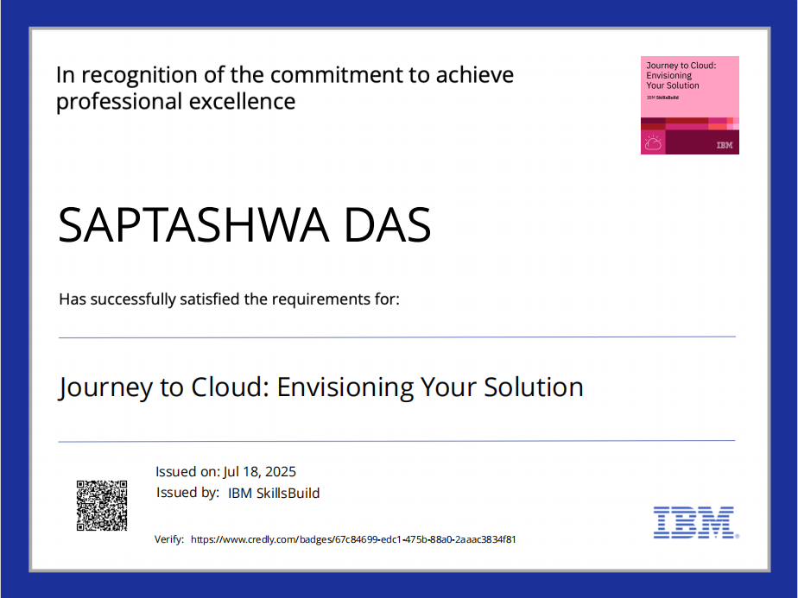
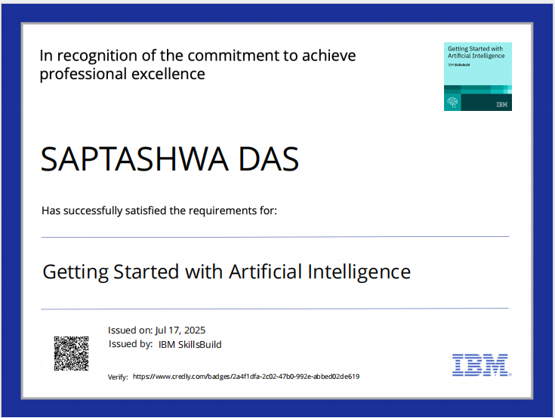
IBM Certifications

Slide 16
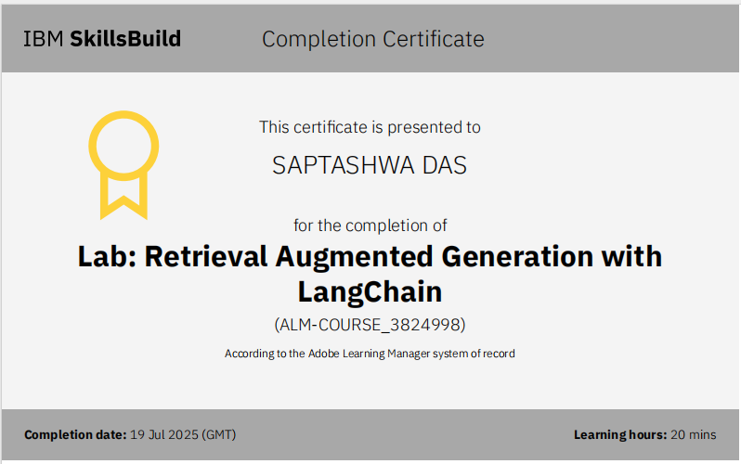

Slide 17
THANK YOU

